Slide 1

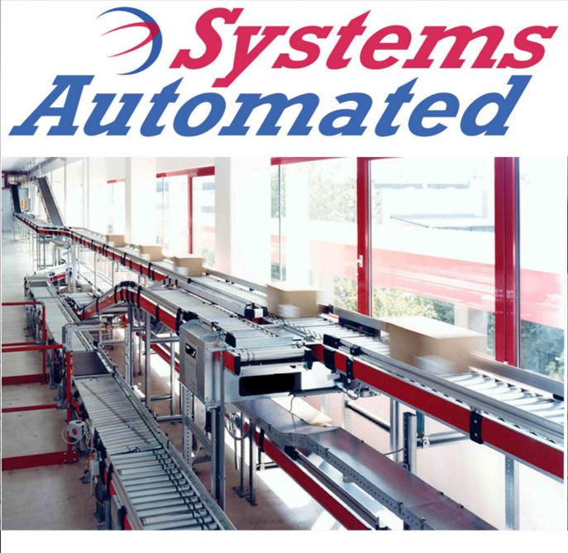
+PLUS
WAREHOUSE CONTROL SYSTEM (WCS)
The +PLUS family of WCS software provides operations, maintenance and management the control and data to maximize operational efficiency,

Slide 2
+PLUS
WHAT YOU NEED AND NOTHING MORE.
Choose and pay for only
INTEGRATED & MODULAR
+BASE
The base HMI package to which additional +PLUS modules may be added.
+HOST
WMS, ERP, SAP or In-house host interface
the modules you need.
Activate additional
+REPORT
Standard and customizable reporting
modules as your
+SORT
Stand-alone sortation based upon bar coded destinations
business requirements
change.
+WEIGH & DIMENSION
In motion weighing and dimensioning
+LABEL
Label generation and in motion application
+PICK & PASS
Carton and tote order routing
+MERGE
Sequential merging
+PALLETIZE
Robotic palletizing
+CONNECT
P2L, P2V, Carousel and VLM data routing
+NOTIFY
Text and email notification of alarms and events
+PORTABLE
Access remotely via smart phone or tablet
1

Slide 3
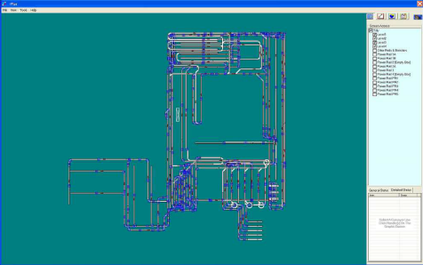
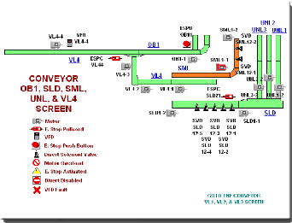
+BASE
What is It?
A HMI (Human-Machine
Interface) with a graphical display of conveyor showing status, events and alarms to which additional +PLUS modules may
be added
How it Works:
Benefits:
The PLC (Programmable Logic
Controller) provides information to the PC which displays the events and alarms.
Events and alarms include emergency stops, full lines, motor overloads and jams
95% of calls to engineering
support are caused by
tripped emergency stops and
sensors out of alignment.
Being shown which
emergency stop is tripped
means the location is quickly identified and corrected.
If a line shows as full, but is
not, then the sensor is out of alignment. The sensor is quickly aligned and operation returned normal.
Even with normal operation
additional personnel may be needed in a specific location due to a bottleneck – this is clearly shown.
A quick look by supervisory or maintenance personnel shows them if everything is ok or a specific problem exists.
2

Slide 4
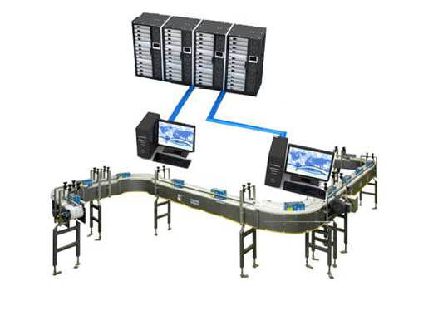
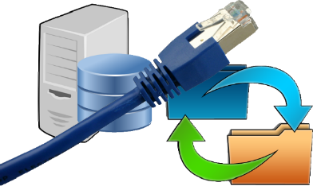
+Host
What is It?
Interface with customer
WMS, ERP, SAP or In-
House programs
How it Works:
Custom software is provided to interface with customer WMS, ERP, SAP or In-House Host programs
Various communication protocols may be used
(FTP, TCP/IP, Socket, SQL Database Query, or In-House Custom Protocol) based on customer requirements and specifications
Benefits:
We customize our software so the customer software modifications are minimized.
All needed and
available data such as order numbers, picking locations and freight carriers is painlessly retrieved from the customer files and databases.
3

Slide 5
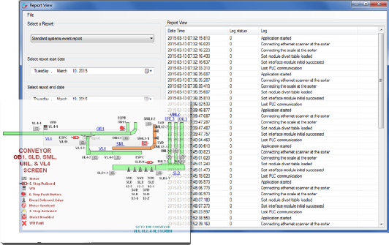
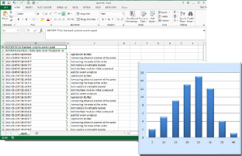
+REPORT
What is It?
Software which gathers
information from the system for display and saving to a file based
on what the customer needs.
Benefits:
Knowing when picked orders reach packing and shipping provides an opportunity to schedule personnel start times.
Order delays due to full areas are able to be addressed by scheduling of personnel most efficiently.
Management oversight of
second and third shift operations is improved with time and date stamped records of what happens when they are not there.
Throughput, alarm and event data by location, time and duration is loaded into .csv files each day for retrieval and analysis in Excel. This allows management to measure performance of each department.
4

Slide 6
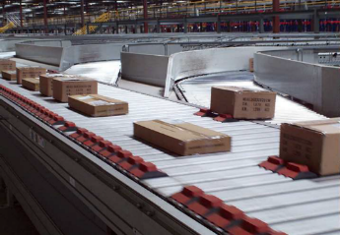
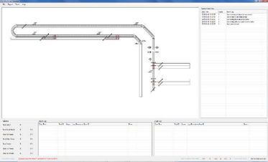
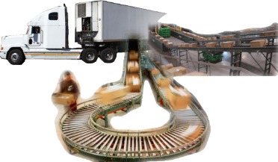
+SORT
What is It?
A stand-alone or integrated
sortation system for routing cartons to the correct location
How it Works:
Product bar code is scanned for identification
Product is routed to a final
destination based on user defined criteria such as carrier, order number, customer or next day vs ground shipping.
Routing decisions are based on predefined destinations or routing tables located on a local PC or remote customer server via +HOST
Benefits:
Product is sorted to a specific dock door for faster loading of trucks with fewer personnel.
Carrier personnel may be
utilized for loading because only the freight they ship is delivered to them.
5

Slide 7
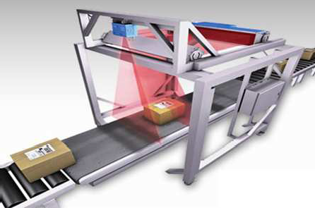
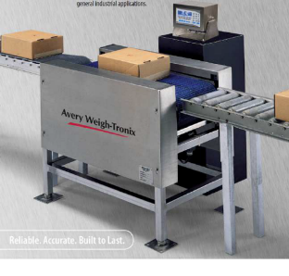
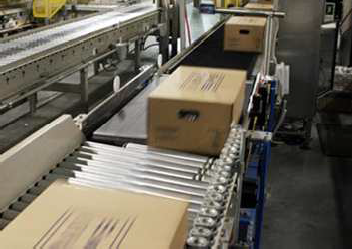
+WEIGH & DIMENSION
What is It?
In motion scanning, weighing,
and dimensioning
Benefits:
By marrying the weight and dimensions of the product to a scanned barcode and then recording the data into a database throughput and accuracy are greatly increased because the carton does not stop and manual weighing and dimensioning by personnel are not needed.
6

Slide 8
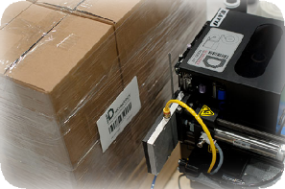
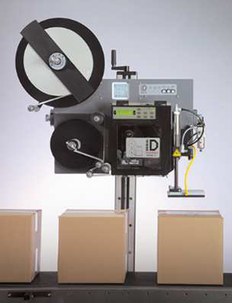
+LABEL
What is It?
In motion labeling of cartons.
How it Works:
A carton bar code is scanned
A database is queried for the appropriate label information
The label is printed and applied
Benefits:
Automated printing and applying of labels reduces labor, increases accuracy and throughput because the carton is labeled without stopping and manual labeling by personnel is not needed.
7

Slide 9
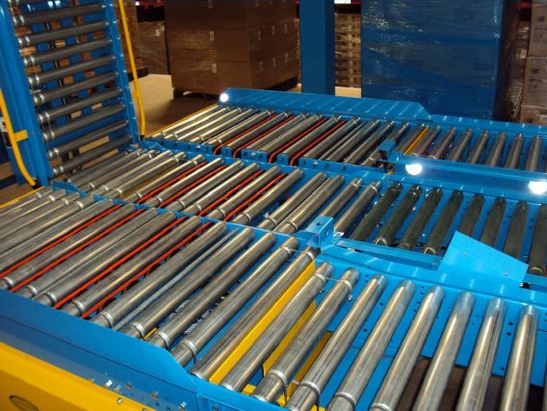
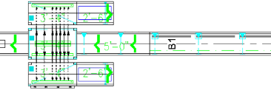
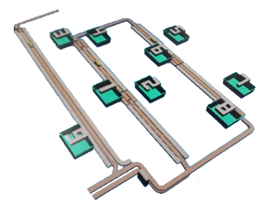
+PICK & PASS
What is It?
Automated routing of cartons and
totes based upon bar codes to specific pick zones based as determined by the customer
though manual entry or a WMS.
How it Works:
A barcode or LPN can be either manually assigned or automatically assigned (by query) to multiple destinations
The barcode or LPN is scanned at each pick location and routed accordingly
Benefits:
Personnel are assigned to a limited pick area for greatly reduced travel times
Only the cartons or totes needed are
routed to the picker
8

Slide 10
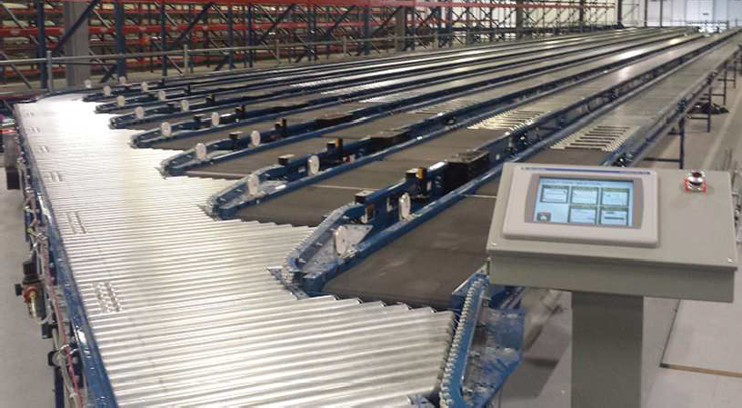
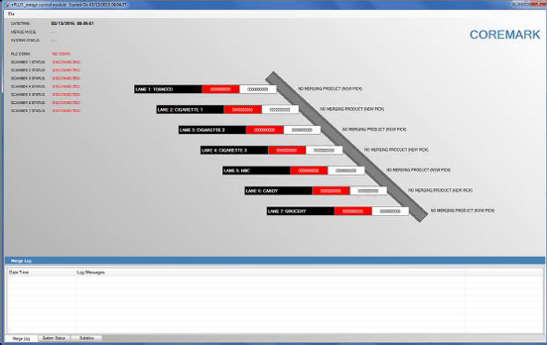
+MERGE
What is It?
Automated merging of orders in a
predetermined sequence
How it Works:
Products arrive from each production area and are scanned
for order number
Products at are released in a prioritized consolidated sequence
Benefits:
Allows the user to effectively combine orders for more efficient palletizing
Delivery trucks are loaded in the proper sequence for efficient delivery
9

Slide 11
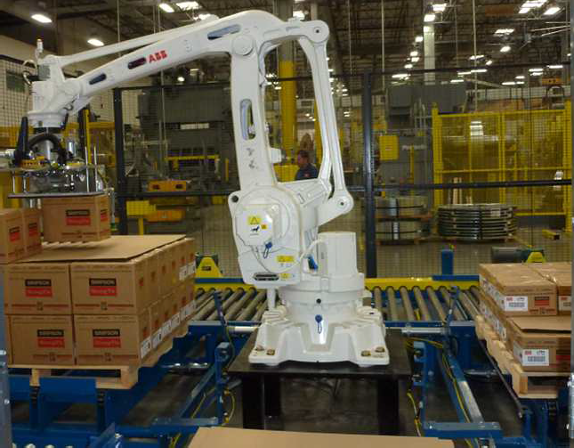
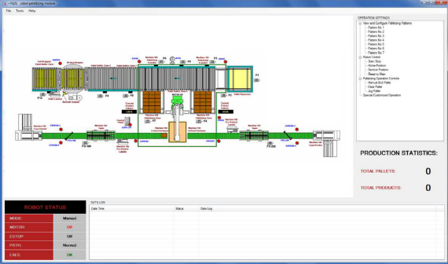
+PALLETIZE
What is It?
Robotic palletizing of product
from one or more production lines
How it Works:
Automatically palletizes cartons based upon product type and predetermined patterns.
Multiple recipes with various patterns and slip sheet specifications
Benefits:
Lower labor requirements
Reduction in lifting of heavy loads
Better, more consistent pallet builds
10

Slide 12

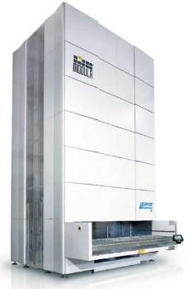
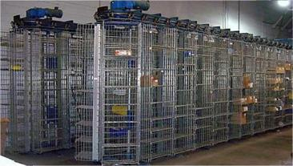
+CONNECT
What is It?
A router of information between
equipment software packages and a host
Benefits:
Using +Connect reduces the need for customer WMS modifications
The information for orders which
are being handled by different types of picking equipment such as carousels, pick to light and VLMs is sent to and from automatically
11

Slide 13
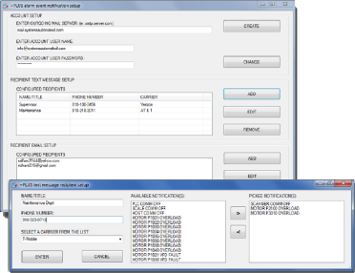
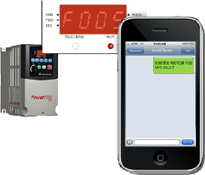
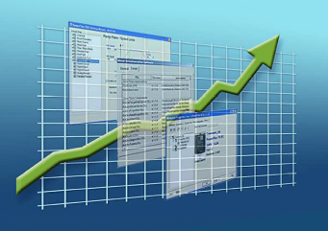
+NOTIFY
What is It?
A notification service utilizing
text and e-mail allowing the end
user to select the types of alarms and events
How it Works:
Simply select the phone carrier and contact number via text or e-mail address for the notifications to be delivered
Select the types of alarms and events to be delivered
When an alarm or event
occurs, the user will be notified based on the selected contact information
Benefits:
Reduced downtime with immediate notification of maintenance personnel.
Supervisor notification for personnel balancing.
12

Slide 14
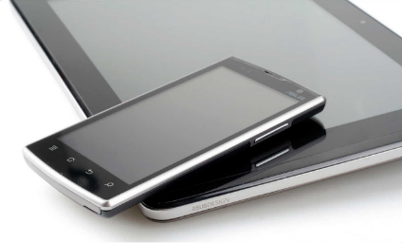
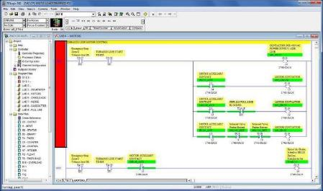
+PORTABLE
What is It?
An android or tablet device
displaying system information for monitoring and troubleshooting
Benefits:
The ability to bring real-time information to the location of the event or problem increases productivity and reduces downtime
13

